Slide 1

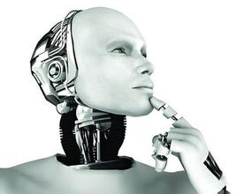
文本分类2
陈海斌
Lab of Machine Learning and Data Mining
South China University of Technology

Slide 2
Outline
Part1 attention的二维扩展与正则化
A Structured Self-attentive Sentence Embedding(2017 ICLR)
Part2 sentence2vec的transformer
DiSAN: Directional Self-Attention Network for RNN/CNN-Free Language Understanding(2018 AAAI)

Slide 3
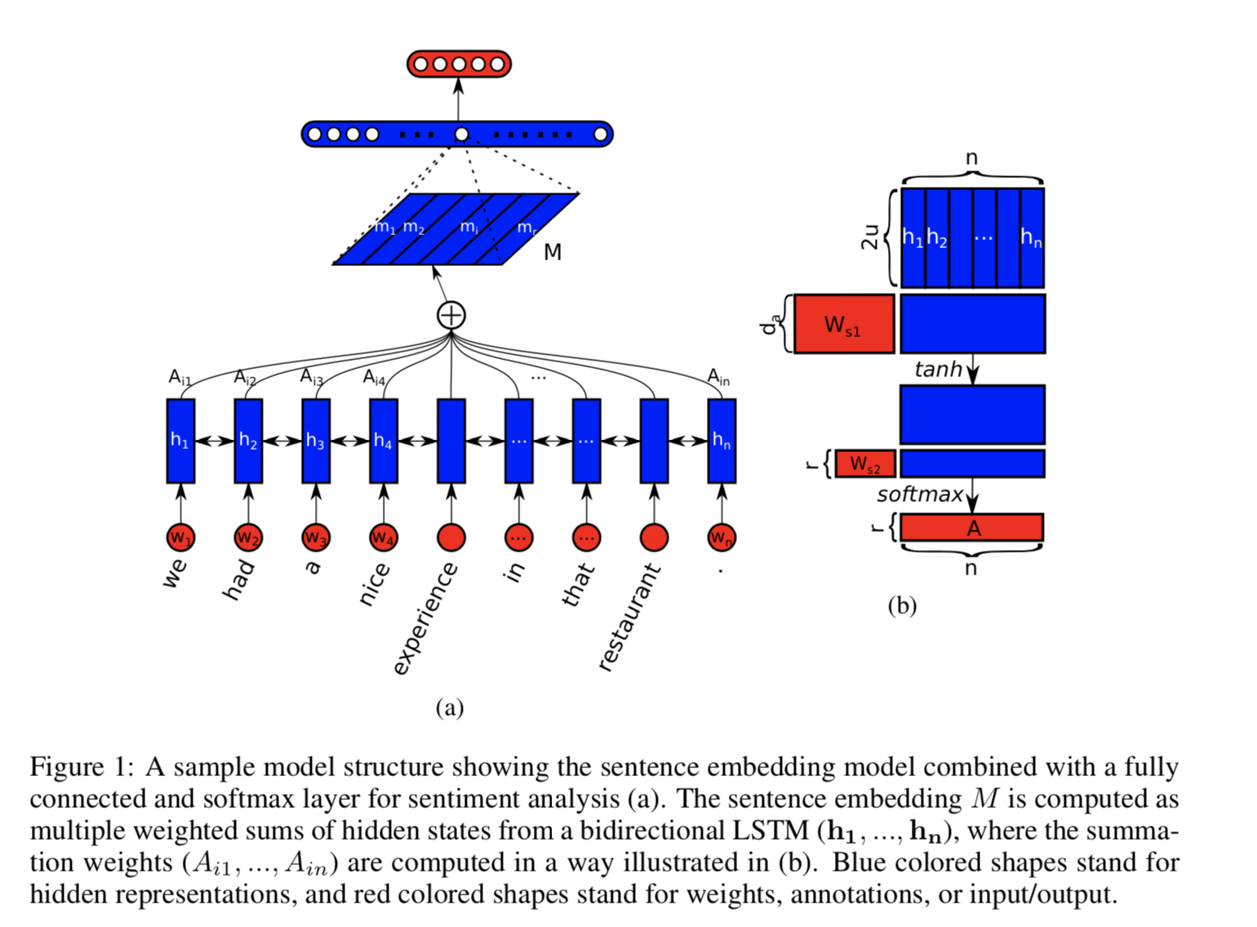
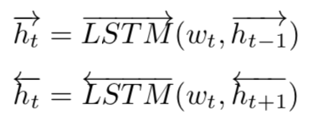
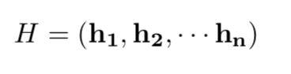
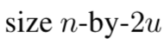
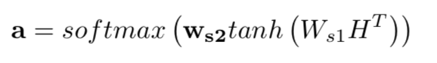
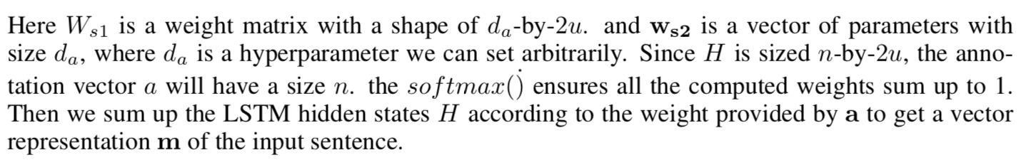
Part1 A Structured Self-attentive Sentence Embedding(2017 ICLR)
传统attention:

Slide 4
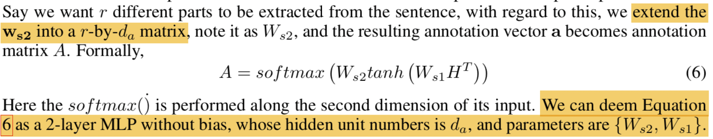
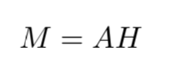
Part1 A Structured Self-attentive Sentence Embedding(2017 ICLR)
1.两层神经网络
2. multiple components in a sentence，Ws2维度 r*da中的r为句子的不同层面，即矩阵每一行代表了句子不同层面的信息
3. attention的attention（不同重点词上的attention）

Slide 5
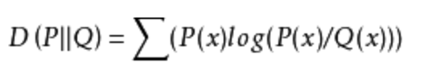
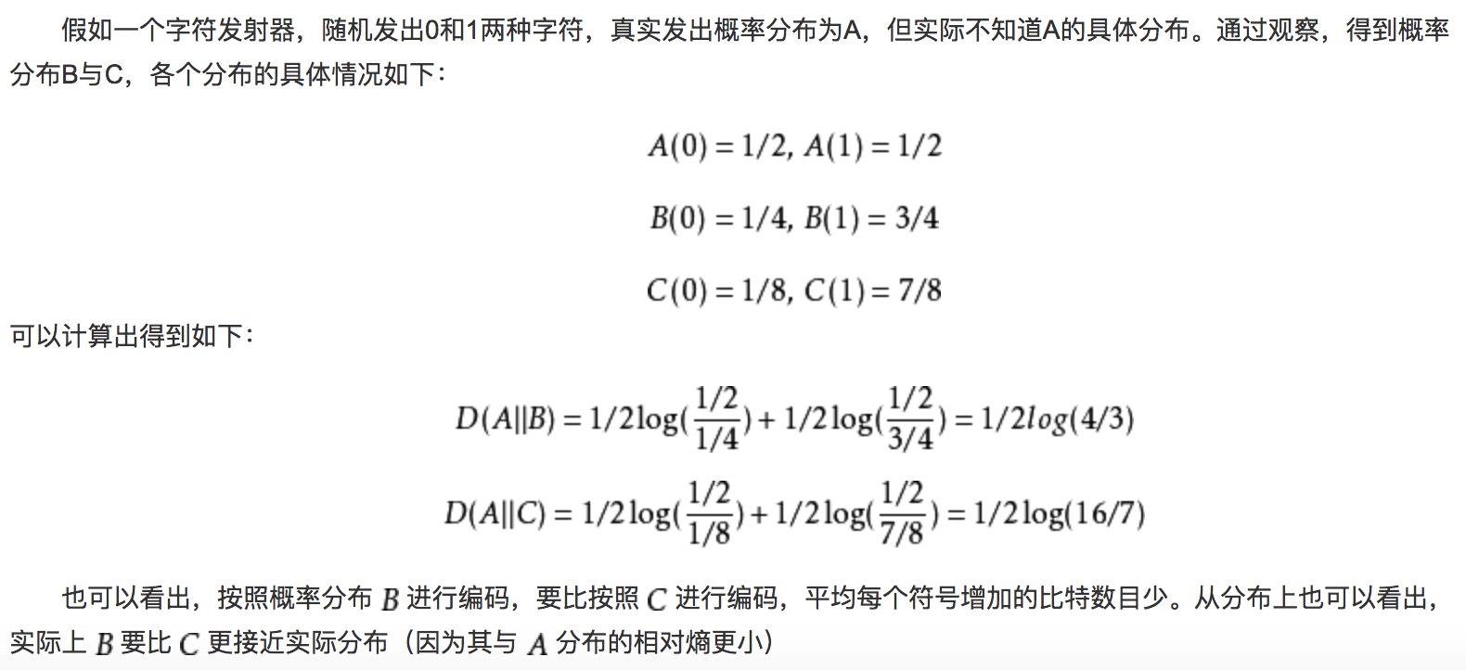
Part1 A Structured Self-attentive Sentence Embedding(2017 ICLR)
训练损失惩罚项：KL散度
1. softmax处后具有大量接近于0的值 使训练变得不稳定
2. we want each individual row to focus on a single aspect of semantics, so we want the probability mass in the annotation softmax output to be more focused. (?)

Slide 6
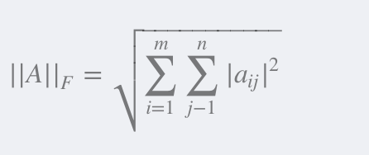
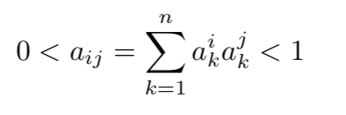
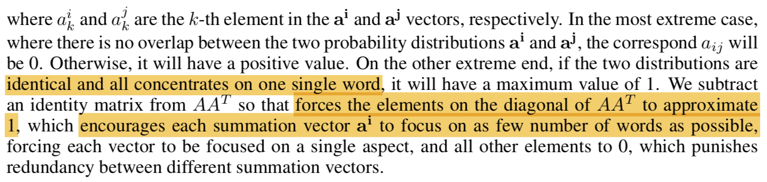
Part1 A Structured Self-attentive Sentence Embedding(2017 ICLR)
惩罚项：
∥•∥F代表矩阵范数。 [该惩罚项P将乘以系数，与原始损失一起最小化，cost=交叉熵+αP，α是调节P的比重的系数(取决于具体任务)]

Slide 7
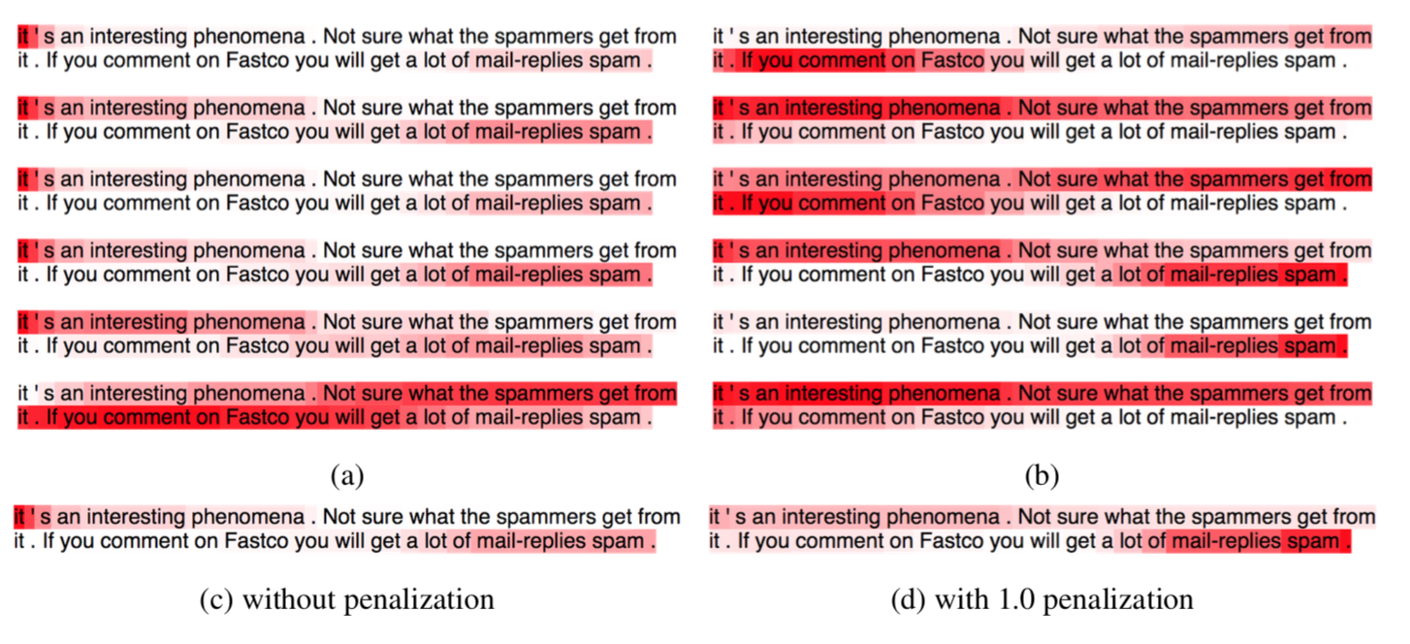
Part1 A Structured Self-attentive Sentence Embedding(2017 ICLR)

Slide 8
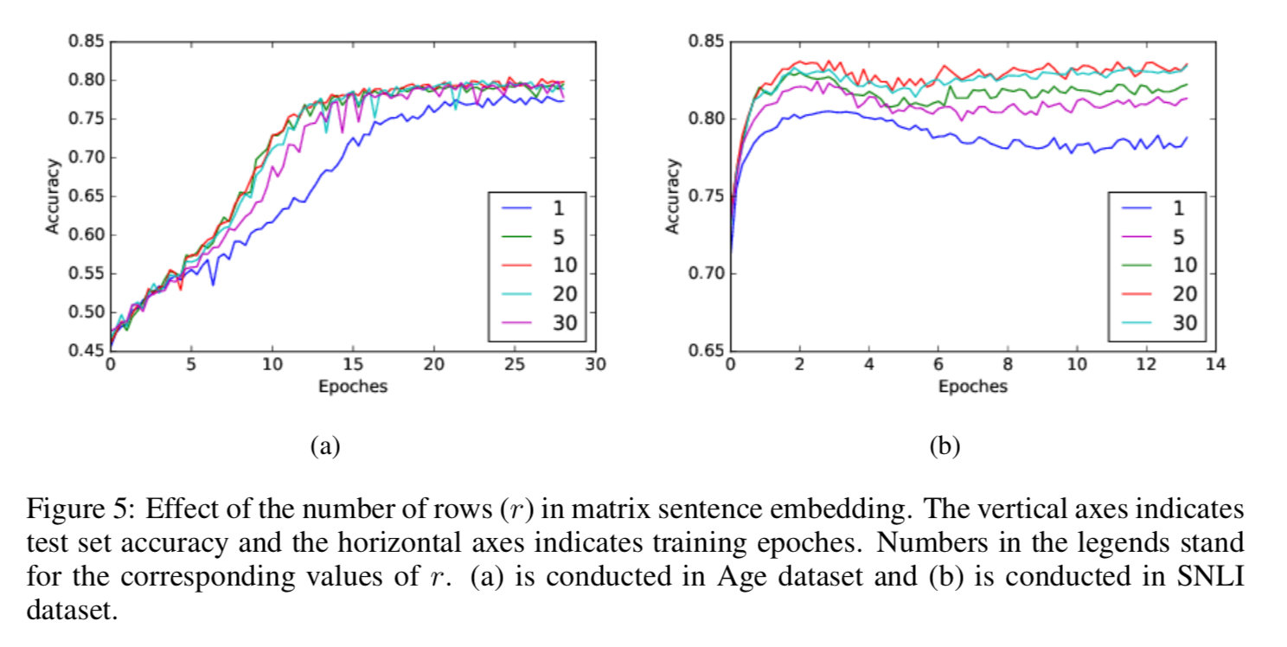
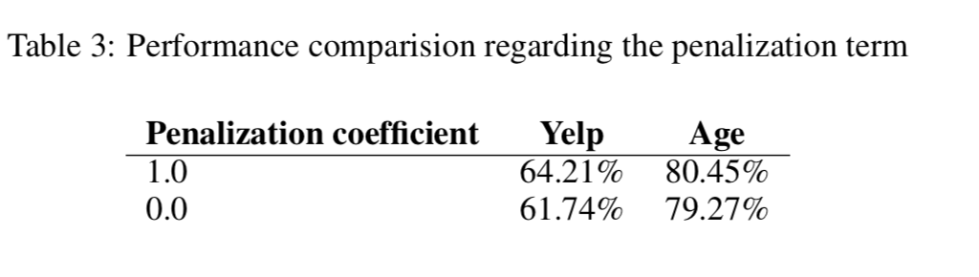
Part1 A Structured Self-attentive Sentence Embedding(2017 ICLR)

Slide 9
Part1 A Structured Self-attentive Sentence Embedding(2017 ICLR)
conclusion：
1. 这个模型最大的不足是超参r的选择太依赖于下游的任务应用，因此难以泛化或进行无监督学习。
2. r的选择不仅受限于下游的任务，可能还受限于句子的长度分布，若句子长度很不均匀，r小的话不足以获取长句子的完整信息，r大的话短句子的focus又过于冗余。
3. 多维attetion减轻了LSTM长期依赖的负担，实验也支持这一点，当内容更长时模型具有优势。

Slide 10
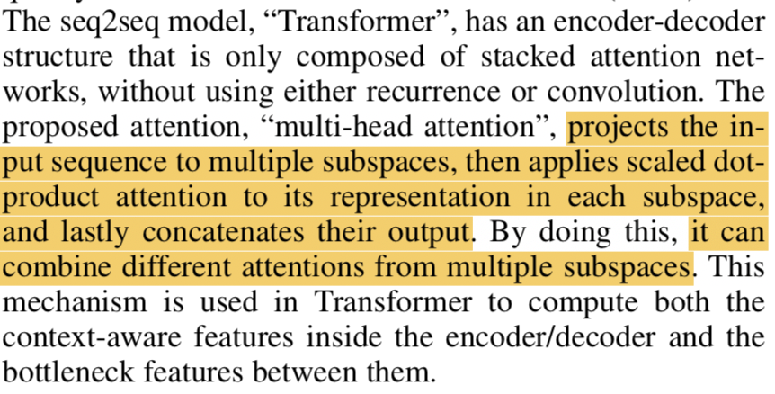
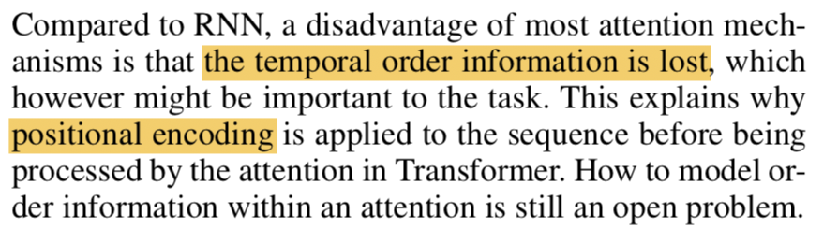
Part2 DiSAN: Directional Self-Attention Network for RNN/CNN-Free Language Understanding(2018 AAAI)
1.self-attention
2.position encoding

Slide 11
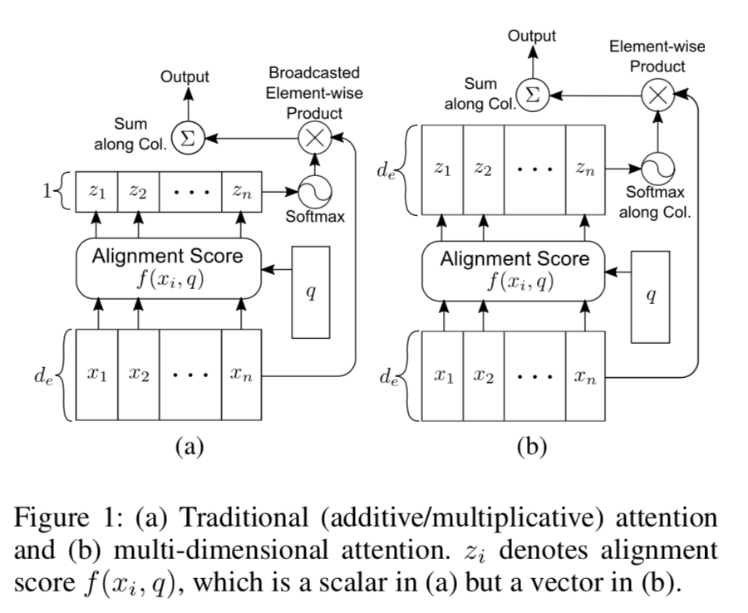
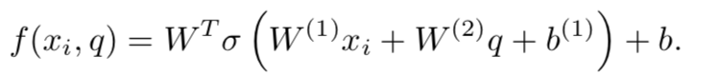
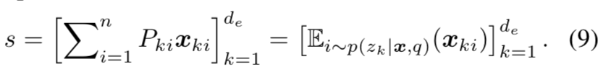
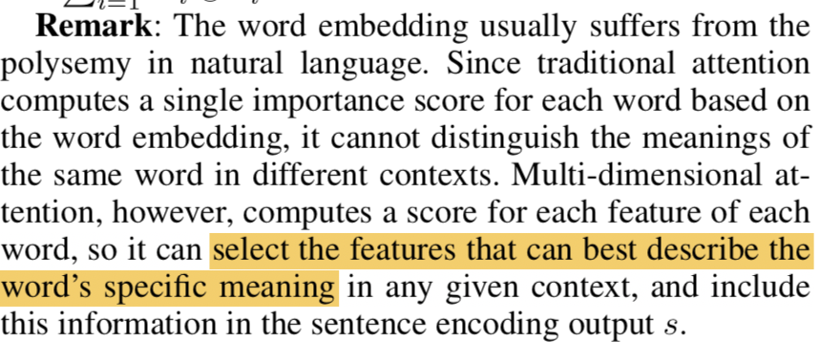
Part2 DiSAN: Directional Self-Attention Network for RNN/CNN-Free Language Understanding(2018 AAAI)
引入二维attention

Slide 12
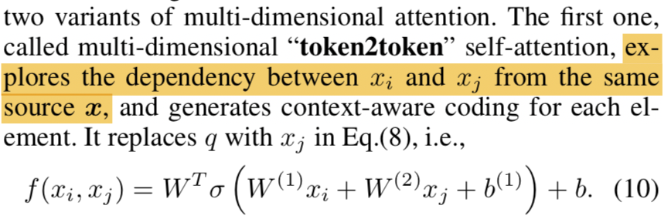
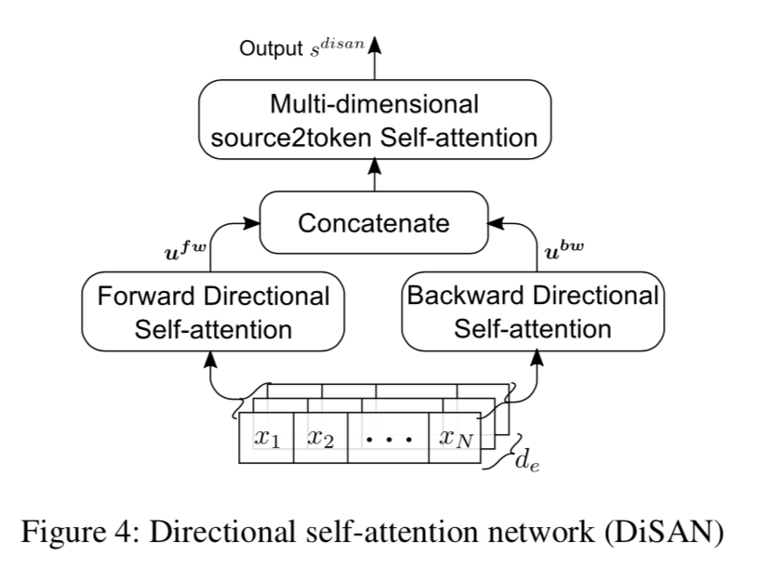
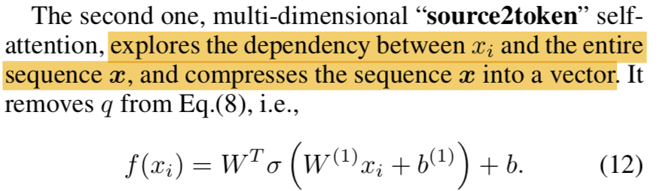
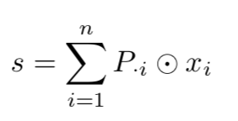
Part2 DiSAN: Directional Self-Attention Network for RNN/CNN-Free Language Understanding(2018 AAAI)
两种attention：

Slide 13
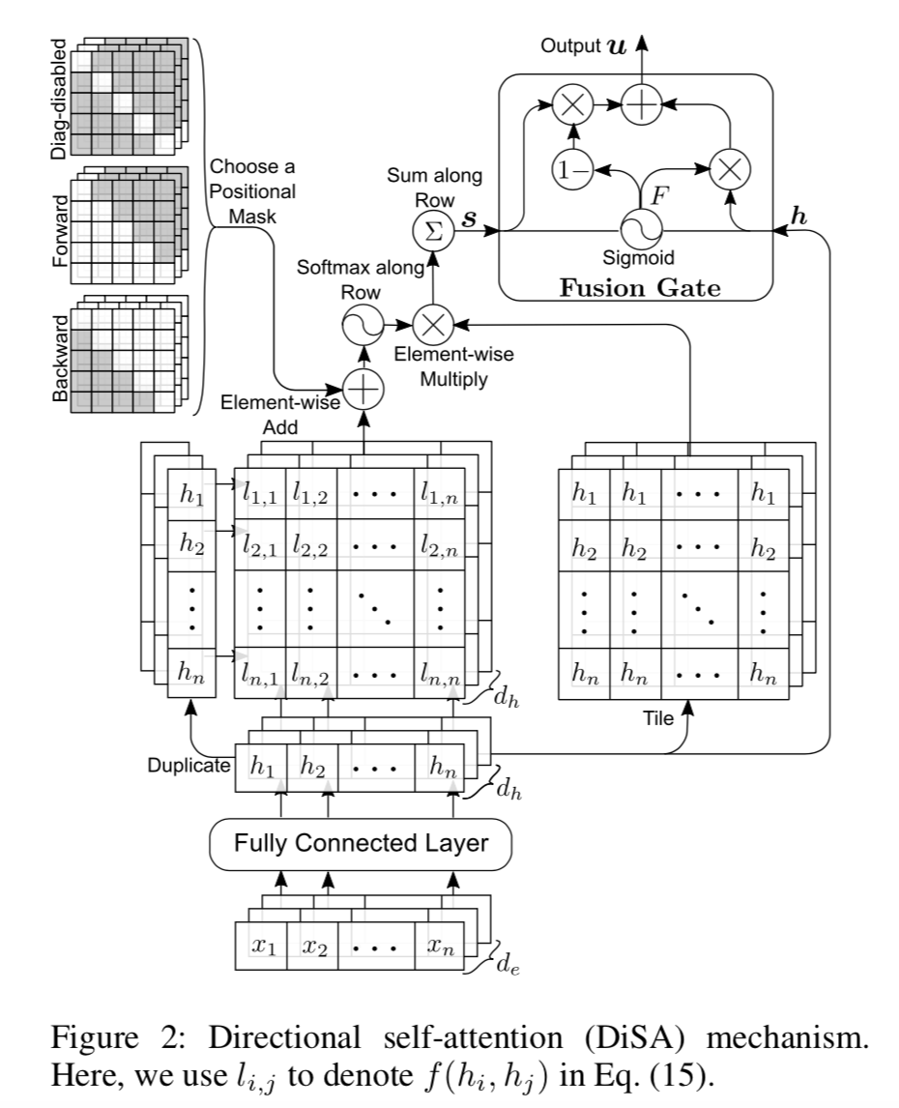
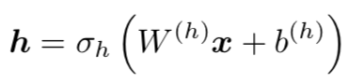
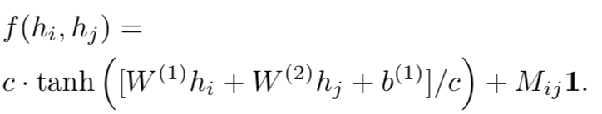
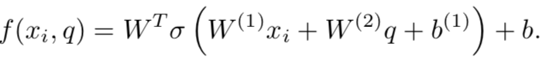
Part2 DiSAN: Directional Self-Attention Network for RNN/CNN-Free Language Understanding(2018 AAAI)
Fully connected layer
Token2token-attention
(原来)
Reduce parameter, set c=5 to obtain stable output
Position-mask: forward, backward, diag-disabled

Slide 14
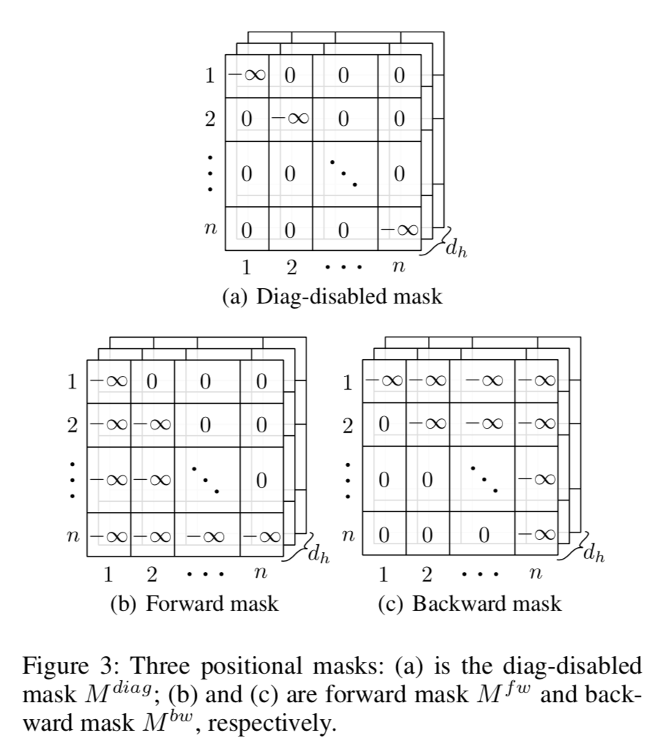
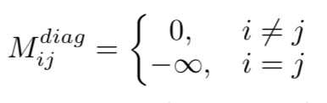
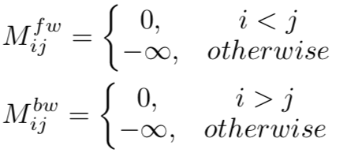
Part2 DiSAN: Directional Self-Attention Network for RNN/CNN-Free Language Understanding(2018 AAAI)
Diabled the attention of every token itself
Forward and backward mask
concat

Slide 15
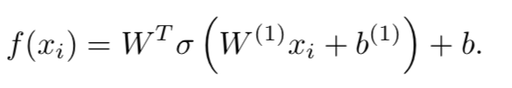
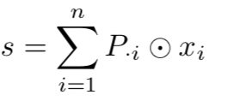
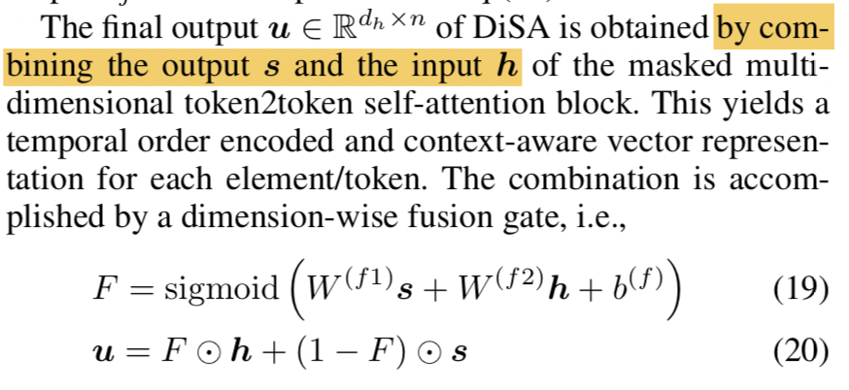
Part2 DiSAN: Directional Self-Attention Network for RNN/CNN-Free Language Understanding(2018 AAAI)
Source2token(不变)
Fusion gate

Slide 16
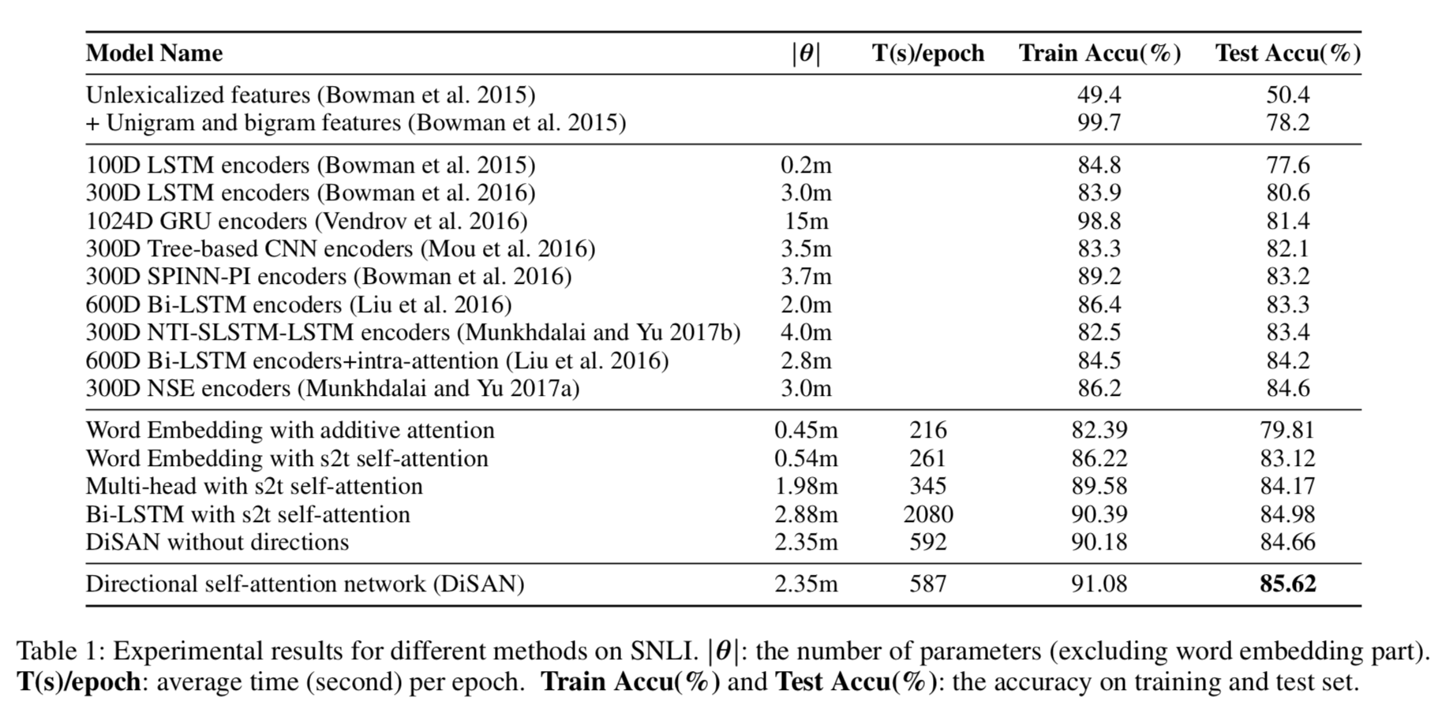
Part2 DiSAN: Directional Self-Attention Network for RNN/CNN-Free Language Understanding(2018 AAAI)
Result:下游任务均state of art：NLI, sentiment analysis, Sentence Classifications, Semantic Relatedness

Slide 17
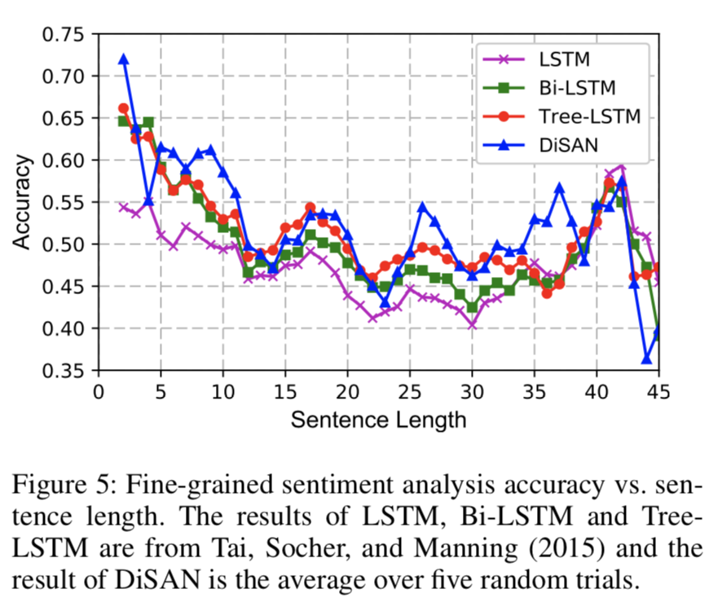
Part2 DiSAN: Directional Self-Attention Network for RNN/CNN-Free Language Understanding(2018 AAAI)
Other conclusion:
1.句子长度太长准确率下降
2. F is large，倾向于使用原本的隐层信息

Slide 18
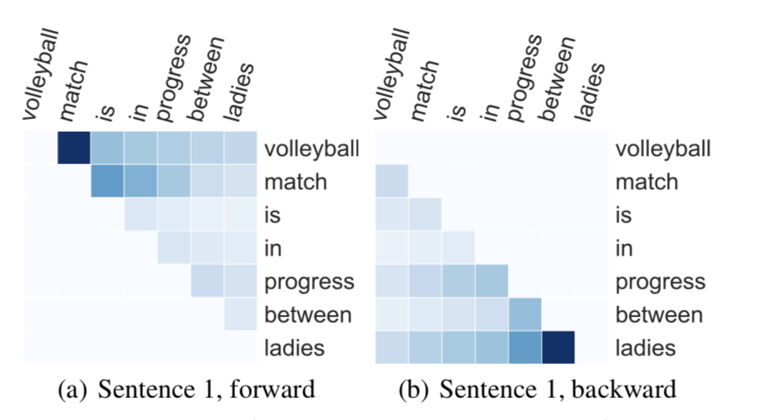
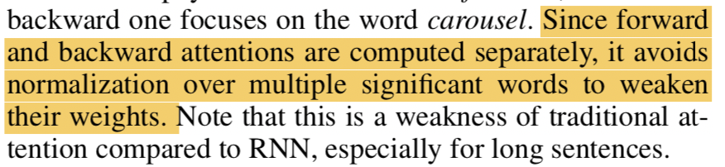
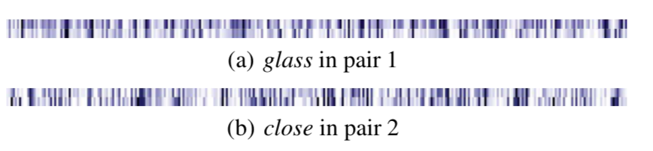
Part2 DiSAN: Directional Self-Attention Network for RNN/CNN-Free Language Understanding(2018 AAAI)
Other conclusion:
3.Global important word(nouns and verbs)
Phrase or sense-group

Slide 19
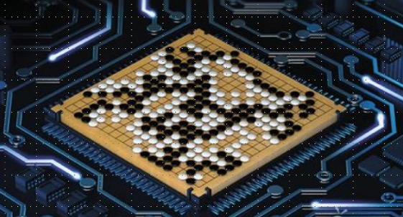
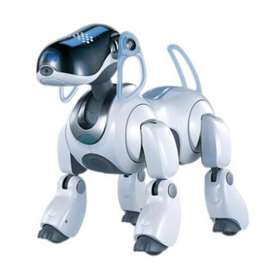
Thanks for your listening ...

